Slide 1
R. Johnsonbaugh
Discrete Mathematics
5th edition, 2001
Chapter 6
Graph Theory

Slide 2
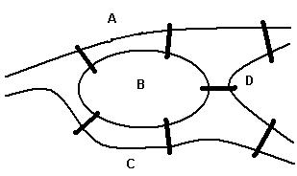
In the beginning…
1736: Leonhard Euler
    Basel, 1707-St. Petersburg, 1786
    He wrote A solution to a problem concerning the geometry of a place. First paper in graph theory.
Problem of the Königsberg bridges:
    Starting and ending at the same point, is it possible to cross all seven bridges just once and return to the starting point?

Slide 3
Some important names
Thomas Pennington Kirkman (Manchester, England 1806-1895)
  British clergyman who studied combinatorics.
William Rowan Hamilton (Dublin, Ireland 1805-1865)
  applied "quaternions"
  worked on optics, dynamics and analysis
  created the "icosian game" in 1857, a precursor of Hamiltonian cycles.
Denes Konig (Budapest, Hungary 1844-1944)
  Interested in four-color problem and graph theory
  1936: publishes Theory of finite and infinite graphs, the first textbook on graph theory

Slide 4
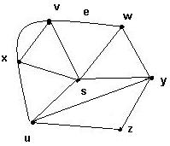
6.1 Introduction
What is a graph G?
It is a pair G = (V, E), where
  V = V(G) = set of vertices
  E = E(G) = set of edges
Example:
  V = {s, u, v, w, x, y, z}
  E = {(x,s), (x,v)₁, (x,v)₂, (x,u), (v,w), (s,v), (s,u), (s,w), (s,y), (w,y), (u,y), (u,z),(y,z)}

Slide 5
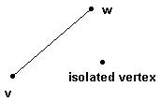
Edges
An edge may be labeled by a pair of vertices, for instance e = (v,w).
e is said to be incident on v and w.
Isolated vertex = a vertex without incident edges.

Slide 6
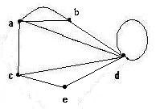
Special edges
Parallel edges
  Two or more edges joining a pair of vertices
    in the example, a and b are joined by two parallel edges
Loops
  An edge that starts and ends at the same vertex
    In the example, vertex d has a loop

Slide 7
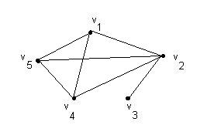
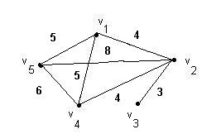
Special graphs
Simple graph
  A graph without loops or parallel edges.
Weighted graph
  A graph where each edge is assigned a numerical label or “weight”.

Slide 8
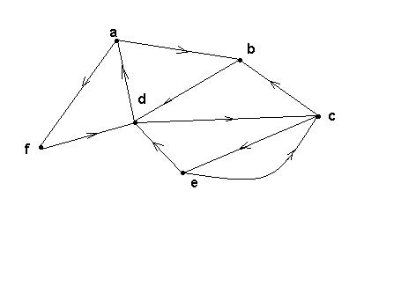
Directed graphs (digraphs)
G is a directed graph or digraph if each edge has been associated with an ordered pair of vertices, i.e. each edge has a direction

Slide 9
Similarity graphs (1)
Problem: grouping objects into similarity classes based on various properties of the objects.
  Example:
  Computer programs that implement the same algorithm have properties k = 1, 2 or 3 such as:
  1. Number of lines in the program
  2. Number of “return” statements
  3. Number of function calls

Slide 10
Similarity graphs (2)
Suppose five programs are compared and a table is made:
Program | # of lines | # of “return” | # of function calls
1 | 66 | 20 | 1
2 | 41 | 10 | 2
3 | 68 | 5 | 8
4 | 90 | 34 | 5
5 | 75 | 12 | 14

Slide 11
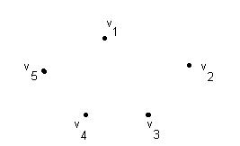
Similarity graphs (3)
A graph G is constructed as follows:
  V(G) is the set of programs {v₁, v₂, v₃, v ₄, v₅ }.
  Each vertex v_{i} is assigned a triple (p₁, p₂, p₃),
  where p_{k} is the value of property k = 1, 2, or 3
  v₁ = (66,20,1)
  v₂ = (41, 10, 2)
  v₃ = (68, 5, 8)
  v₄ = (90, 34, 5)
  v₅ = (75, 12, 14)

Slide 12
Dissimilarity functions (1)
Define a dissimilarity function as follows:
  For each pair of vertices v = (p₁, p₂, p₃) and w = (q₁, q₂, q₃) let ₃
s(v,w) = Σ |p_{k} – q_{k}|
^{k = 1}
s(v,w) is a measure of dissimilarity between any two programs v and w
Fix a number N. Insert an edge between v and w if s(v,w) < N. Then:
We say that v and w are in the same class if v = w or if there is a path between v and w.

Slide 13
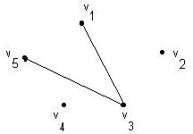
Dissimilarity functions (2)
Let N = 25.
s(v₁,v₃) = 24, s(v₃,v₅) = 20 and all other s(v_{i},v_{j}) > 25
There are three classes:
{v₁,v₃, v₅}, {v₂} and {v₄}
The similarity graph looks like the picture

Slide 14
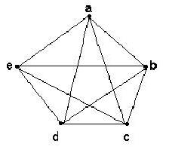
Complete graph K _{n}
Let n > 3
The complete graph K_{n} is the graph with n vertices and every pair of vertices is joined by an edge.
The figure represents K₅

Slide 15
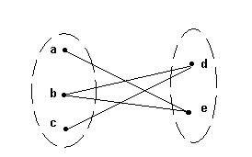
Bipartite graphs
A bipartite graph G is a graph such that
  V(G) = V(G₁) ∪ V(G₂)
  |V(G₁)| = m, |V(G₂)| = n
  V(G₁) ∩V(G₂) = ∅
  No edges exist between any two vertices in the same subset V(G_{k}), k = 1,2

Slide 16
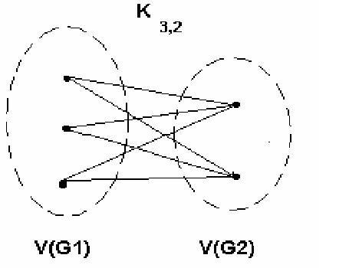
Complete bipartite graph K_{m,n}
A bipartite graph is the complete bipartite graph K_{m,n} if every vertex in V(G₁) is joined to a vertex in V(G₂) and conversely,
|V(G₁)| = m
|V(G₂)| = n

Slide 17
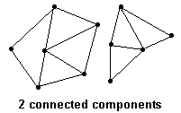
Connected graphs
A graph is connected if every pair of vertices can be connected by a path
Each connected subgraph of a non-connected graph G is called a component of G

Slide 18
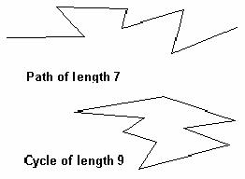
6.2 Paths and cycles
A path of length n is a sequence of n + 1 vertices and n consecutive edges
A cycle is a path that begins and ends at the same vertex

Slide 19
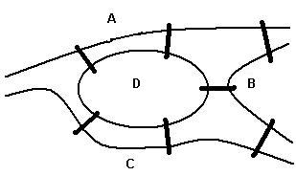
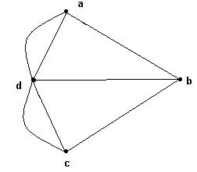
Euler cycles
An Euler cycle in a graph G is a simple cycle that passes through every edge of G only once.
The Königsberg bridge problem:
  Starting and ending at the same point, is it possible to cross all seven bridges just once and return to the starting point?
This problem can be represented by a graph
Edges represent bridges and each vertex represents a region.

Slide 20
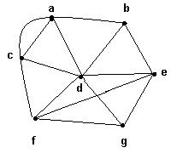
Degree of a vertex
The degree of a vertex v, denoted by δ(v), is the number of edges incident on v
Example:
  δ(a) = 4, δ(b) = 3,
  δ(c) = 4, δ(d) = 6,
  δ(e) = 4, δ(f) = 4,
  δ(g) = 3.

Slide 21
Euler graphs
A graph G is an Euler graph if it has an Euler cycle.
Theorems 6.2.17 and 6.2.18: G is an Euler graph if and only if G is connected and all its vertices have even degree.
The connected graph represents the Konigsberg bridge problem.
It is not an Euler graph.
Therefore, the Konigsberg bridge problem has no solution.

Slide 22
Sum of the degrees of a graph
Theorem 6.2.21: If G is a graph with m edges and n vertices v₁, v₂,…, v_{n}, then
_{n}
Σ δ(v_{i}) = 2m
^{i = 1}
In particular, the sum of the degrees of all the vertices of a graph is even.

Slide 23
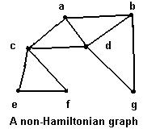
6.3 Hamiltonian cycles
Traveling salesperson problem
  To visit every vertex of a graph G only once by a simple cycle.
  Such a cycle is called a Hamiltonian cycle.
  If a connected graph G has a Hamiltonian cycle, G is called a Hamiltonian graph.

Slide 24
Gray codes
Considered as a graph, a ring model for parallel computation is a cycle.
A Gray code is a sequence s₁, s₂,…, s ₂^{n} such that
  every n-bit string appears somewhere in the sequence
  s_{k} and s_{k+1} differ in exactly one bit
  And s ₂^{n} and s₁ differ in exactly one bit.

Slide 25

Parallel computation models (1)
The n-cube I^{n} has 2^{n} processors, n > 1
  Vertices are labeled 0, 1, 2,…, 2^{n-1}
  An edge connects two vertices if the binary representation of their labels differs in exactly one bit
  The n-cube simulates a ring model with 2^{n} processors if it contains a simple cycle with 2^{n} vertices which is a Hamiltonian cycle
  The n-cube (n > 2) has a Gray code, therefore it contains a simple Hamiltonian cycle with 2^{n} vertices, and so it is a model for parallel computation.
  I¹ has only two vertices 0 and 1. It has no cycles.

Slide 26

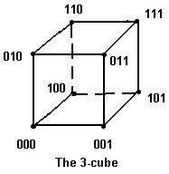
Parallel computation models (2)
  I² (a square) has 4 vertices labeled 00, 01, 10 and 11
  A Hamiltonian cycle is (00, 01, 11, 10, 00)
  I³ (a cube) has 8 vertices labeled 000, 001, 010, 011, 100, 101 and 111
  A Hamiltonian cycle is (000, 001, 011, 010, 110, 111, 101, 100, 000)

Slide 27
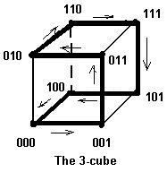
The 3-cube
The Hamiltonian cycle (000, 001, 011, 010, 110, 111, 101, 100, 000) joins vertices that differ by one bit.

Slide 28
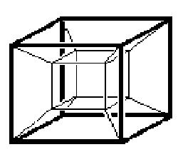
The hypercube or 4-cube
I⁴ (the hypercube)
has16 vertices, 32 edges and 20 faces
Vertex labels:
0000 0001 0010 0011
0100 0101 0110 0111
1000 1001 1010 1011
1100 1101 1110 1111

Slide 29
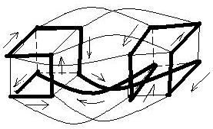
A Hamiltonian cycle on the hypercube

Slide 30
6.4 A shortest-path algorithm
Due to Edsger W. Dijkstra, Dutch computer scientist born in 1930
Dijkstra's algorithm finds the length of the shortest path from a single vertex to any other vertex in a connected weighted graph.
For a simple, connected, weighted graph with n vertices, Dijkstra’s algorithms has worst-case run time Θ(n²).

Slide 31
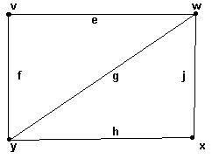
6.5 Representations of graphs
Adjacency matrix
  Rows and columns are labeled with ordered vertices
  write a 1 if there is an edge between the row vertex and the column vertex
  and 0 if no edge exists between them
 | v | w | x | y
v | 0 | 1 | 0 | 1
w | 1 | 0 | 1 | 1
x | 0 | 1 | 0 | 1
y | 1 | 1 | 1 | 0

Slide 32
Incidence matrix
Incidence matrix
  Label rows with vertices
  Label columns with edges
  1 if an edge is incident to a vertex, 0 otherwise
 | e | f | g | h | j
v | 1 | 1 | 0 | 0 | 0
w | 1 | 0 | 1 | 0 | 1
x | 0 | 0 | 0 | 1 | 1
y | 0 | 1 | 1 | 1 | 0

Slide 33
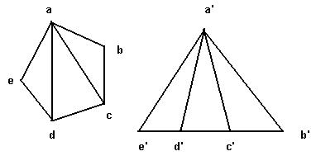
6.6 Isomorphic graphs
G₁ and G₂ are isomorphic
if there exist one-to-one onto functions f: V(G₁) → V(G₂) and g: E(G₁) → E(G₂) such that
an edge e is adjacent to vertices v, w in G₁ if and only if g(e) is adjacent to f(v) and f(w) in G₂

Slide 34
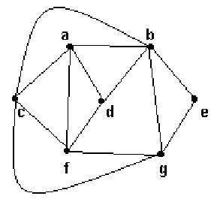
6.7 Planar graphs
A graph is planar if it can be drawn in the plane without crossing edges

Slide 35
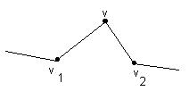
Edges in series
Edges in series:
If v ∈ V(G) has degree 2 and there are edges (v, v₁), (v, v₂) with v₁ ≠ v₂,
we say the edges (v, v₁) and (v, v₂) are in series.

Slide 36
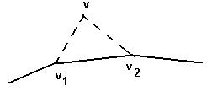
Series reduction
A series reduction consists of deleting the vertex v ∈ V(G) and replacing the edges (v,v₁) and (v,v₂) by the edge (v₁,v₂)
The new graph G’ has one vertex and one edge less than G and is said to be obtained from G by series reduction

Slide 37
Homeomorphic graphs
Two graphs G and G’ are said to be homeomorphic if G’ is obtained from G by a sequence of series reductions.
  By convention, G is said to be obtainable from itself by a series reduction, i.e. G is homeomorphic to itself.
Define a relation R on graphs: GRG’ if G and G’ are homeomorphic.
R is an equivalence relation on the set of all graphs.

Slide 38
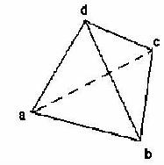
Euler’s formula
If G is planar graph,
  v = number of vertices
  e = number of edges
  f = number of faces, including the exterior face
Then: v – e + f = 2

Slide 39
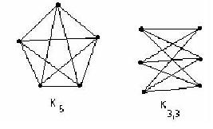
Kuratowski’s theorem
G is a planar graph if and only if G does not contain a subgraph homeomorphic to either K ₅ or K _{3,3}

Slide 40
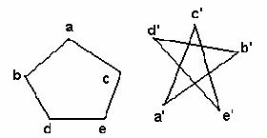
Isomorphism and adjacency matrices
Two graphs are isomorphic if and only if
after reordering the vertices their adjacency matrices are the same
 | a | b | c | d | e
a | 0 | 1 | 1 | 0 | 0
b | 1 | 0 | 0 | 1 | 0
c | 1 | 0 | 0 | 0 | 1
d | 0 | 1 | 0 | 0 | 1
e | 0 | 0 | 1 | 1 | 0

